Slide 1
Capstone Project
The Battle of Neighborhoods
Finding a Better Place in Scarborough, Toronto

Slide 2
The purpose of this Capstone Project is to help people in exploring better facilities around their neighborhood. It will help people making smart and efficient decision on selecting great neighborhood out of numbers of other neighborhoods in Scarborough, TorOnto.
Finding a Better Place

Slide 3
Will use Scarborough dataset which we scrapped from wikipedia on Week 3. Dataset consisting of latitude and longitude, zip codes.
Foursquare API Data:
We will need data about different venues in different neighborhoods of that specific borough.
Data Section

Slide 4
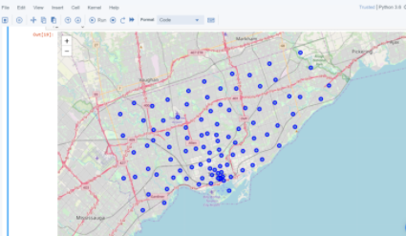
The data retrieved from Foursquare contained information of venues within a specified distance of the longitude and latitude of the postcodes. The information obtained per venue as follows:
Data Section
1. Neighborhood
2. Neighborhood Latitude
3. Neighborhood Longitude
4. Venue
5. Name of the venue e.g. the name of a store or restaurant
6. Venue Latitude
7. Venue Longitude
8. Venue Category

Slide 5
Clustering Approach:
To compare the similarities of two cities, we decided to explore neighborhoods, segment them, and group them into clusters to find similar neighborhoods in a big city like New York and Toronto. To be able to do that, we need to cluster data which is a form of unsupervised machine learning: k-means clustering algorithm.
Methodology Section

Slide 6
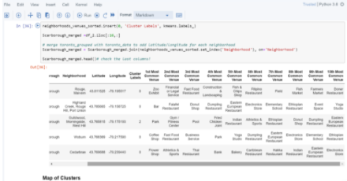
Using K-Means Clustering Approach | Most Common Venue
Methodology Section

Slide 7
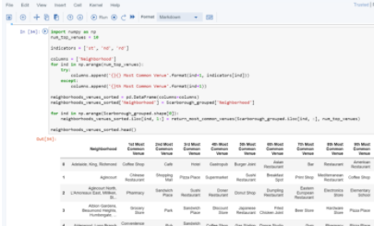
Most Common Venues near Neighborhood | Using Clustering
Methodology Section

Slide 8
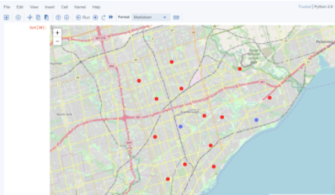
Map of Clusters in Scarborough
Results Section

Slide 9
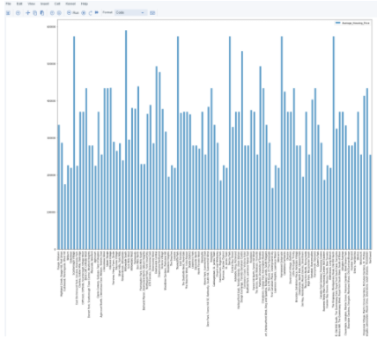
Average Housing Price by Clusters in Scarborough
Results Section

Slide 10
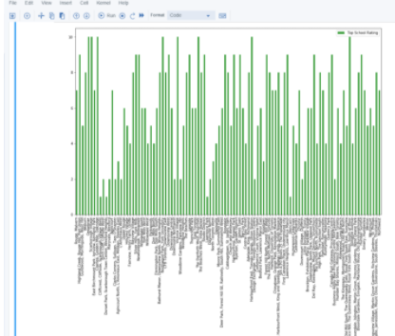
School Ratings by Clusters in Scarborough
Results Section

Slide 11
The Location:
Scarborough is a popular destination for new immigrants in Canada to reside. As a result, it is one of the most diverse and multicultural areas in the Greater Toronto Area, being home to various religious groups and places of worship. Although immigration has become a hot topic over the past few years with more governments seeking more restrictions on immigrants and refugees, the general trend of immigration into Canada has been one of on the rise.
Results Section

Slide 12
The major purpose of this project, is to suggest a better neighborhood in a new city for the person who are shiffting there. Social presence in society in terms of like minded people. Connectivity to the airport, bus stand, city center, markets and other daily needs things nearby.
Sorted list of house in terms of housing prices in a ascending or descending order
Sorted list of schools in terms of location, fees, rating and reviews
Discussion Section

Slide 13
In this Capstone project, using k-means cluster algorithm I separated the neighborhood into 10(Ten) different clusters and for 103 different lattitude and logitude from dataset, which have very-similar neighborhoods around them. Using the charts above results presented to a particular neighborhood based on average house prices and school rating have been made.
Conclusion Section

Slide 14
I feel rewarded with the efforts and believe this course with all the topics covered is well worthy of appreciation.
This project has shown me a practical application to resolve a real situation that has impacting personal and financial impact using Data Science tools.
The mapping with Folium is a very powerful technique to consolidate information and make the analysis and decision better with confidence.
Conclusion Section

Slide 15
Future Works:
This Capstone project can be continued for making it more precise in terms to find best house in Scarborough. Best means on the basis of all required things(daily needs or things we need to live a better life) around and also in terms of cost effective.
Libraries Which are Used to Develope the Project:
Pandas: For creating and manipulating dataframes.
Folium: Python visualization library would be used to visualize the neighborhoods cluster distribution of using interactive leaflet map.
Scikit Learn: For importing k-means clustering.
JSON: Library to handle JSON files.
XML: To separate data from presentation and XML stores data in plain text format.
Geocoder: To retrieve Location Data.
Beautiful Soup and Requests: To scrap and library to handle http requests.
Matplotlib: Python Plotting Module.
Conclusion Section

